Slide 1
Enrique Orbegozo
Consultor Principal
B.S. Consultores
Malas prácticas de programación, impacto y solución

Slide 2
Sobre mi
Quince años en la industria
Trabajando con Oracle desde la versión 7 como desarrollador, DBA y arquitecto
OCP desde Oracle 8 en adelante
Instructor de los cursos de Oracle University
Autor del blog "Snapshot Too Old"
Oracle Ace – Database Management & Performance

Slide 3
Agenda
Introducción
Presentación de cada problema, impacto y forma de resolverlo.
Conclusiones y recomendaciones

Slide 4

Introducción
architecture
PL/SQL
concurrency
optimizer
execution plan
tracing

Slide 5



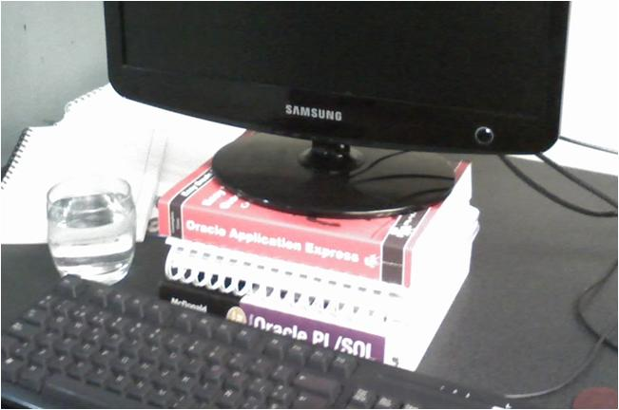



Introducción

Slide 6
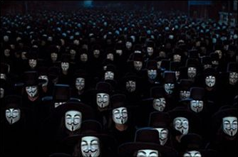
Introducción

Slide 7
Bind variables
kthr memory page faults cpu
----- ----------- ------------------------ ------------ -----------
r b avm fre re pi po fr sr cy in sy cs us sy id wa
12 8 8987479 4448 0 0 0 3371 78729 0 5262 131039 13605 81 6 6 8
12 8 8978449 11349 0 0 0 2608 66498 0 5593 122543 15042 77 5 8 9
17 5 8984329 5622 0 0 0 2964 74991 0 4596 106714 11562 90 5 3 2
17 7 8973652 7426 0 0 0 5334 167860 0 4719 121974 11509 87 5 3 5
15 7 8977178 3699 0 0 0 2455 75515 0 4351 108236 10386 84 5 4 7
18 8 8992529 5432 0 0 0 9502 250040 0 5097 125265 12216 90 6 1 3
13 11 8966226 15028 0 0 0 1094 22430 0 5514 127639 13614 85 6 2 7
12 10 8966427 5012 0 0 0 4453 109251 0 5292 132611 13192 83 5 5 7
12 6 8968769 4846 0 0 0 4454 95967 0 5510 143523 13394 76 6 6 12
16 6 8968522 8318 0 0 0 6140 153464 0 4805 129739 10518 88 5 3 4
8 procesadores Power5 SMT
36GB RAM

Slide 8
Bind variables
SELECT f.IdeFile, f.IdeDoc, f.IdCorr, f.FilePath, f.Descrip, f.IdeRep,
f.IndUso, FILEPATH||LPAD(f.IdeDoc,14,'0')||
'-'||LPAD(f.IdeFile,14,'0')||'.pdf' Archivo
FROM File_Imagenes f WHERE f.IdeRep IN ( SELECT r.IdeRep
FROM Reporte r WHERE r.IdeRep = 5178686 )
AND f.NomRep LIKE 'PDFIMP%' ORDER BY f.IdeFile
SELECT f.IdeFile, f.IdeDoc, f.IdCorr, f.FilePath, f.Descrip, f.IdeRep,
f.IndUso, FILEPATH||LPAD(f.IdeDoc,14,'0')||
'-'||LPAD(f.IdeFile,14,'0')||'.pdf' Archivo
FROM File_Imagenes f WHERE f.IdeRep IN ( SELECT r.IdeRep
FROM Reporte r WHERE r.IdeRep = 5178687 )
AND f.NomRep LIKE 'PDFIMP%' ORDER BY f.IdeFile
SELECT f.IdeFile, f.IdeDoc, f.IdCorr, f.FilePath, f.Descrip, f.IdeRep,
f.IndUso, FILEPATH||LPAD(f.IdeDoc,14,'0')||
'-'||LPAD(f.IdeFile,14,'0')||'.pdf' Archivo
FROM File_Imagenes f WHERE f.IdeRep IN ( SELECT r.IdeRep
FROM Reporte r WHERE r.IdeRep = 5178688 )
AND f.NomRep LIKE 'PDFIMP%' ORDER BY f.IdeFile
. . .

Slide 9
Bind variables
ACME Corporation

Slide 10
Bind variables
Alternativas
cursor_sharing=force
kthr memory page faults cpu
----- ----------- ------------------------ ------------ -----------
r b avm fre re pi po fr sr cy in sy cs us sy id wa
7 9 5356654 1767809 0 0 0 2275 54543 0 6349 122696 17369 55 6 20 19
6 7 5321189 1802992 0 0 0 1366 26947 0 6488 118270 18387 50 5 27 17
6 8 5330993 1792990 0 0 0 2360 33961 0 6640 123847 18897 55 6 23 17
7 7 5341726 1782472 0 0 0 2488 26980 0 6418 109865 18345 53 6 25 16
7 4 5364629 1759543 0 0 0 1905 20431 0 6223 112727 17087 56 5 27 12
4 8 5374184 1750057 0 0 0 4601 59598 0 6826 103141 19154 41 7 31 21
5 7 5435249 1688981 0 0 0 6176 104717 0 6504 100670 19919 39 7 35 18
5 8 5432052 1691856 0 0 0 2989 47766 0 6864 92235 19690 38 6 35 21
5 7 5475717 1648279 0 0 0 3979 48926 0 6670 104124 18664 44 6 33 17
5 10 5703736 1420179 0 0 0 2101 37886 0 2935 68973 7312 47 4 27 21

Slide 11
Bind variables
Alternativas - Java
statement = conn.createStatement();
resultSet = statement.executeQuery(
"SELECT email FROM usuarios "
+ " WHERE usuario = '" + usuario + "'"
+ " AND password = '" + password + "'"
+ " AND f_creacion > " +
dateToSqlString(f_creacion));

Slide 12
Bind variables
Alternativas - Java
String Qry =
"SELECT email FROM usuarios "
+ " WHERE usuario = :1 "
+ " AND password = :2 "
+ " AND f_creacion > :3";
PreparedStatement ps = conn.prepareStatement(Qry);
ps.setString(1, username);
ps.setString(2, password);
ps.setDate(3, f_creacion);

Slide 13
Bind variables
Alternativas – PL/SQL
execute immediate . . .
'select fecha_doc, '|| nSessionId ||
' from documentos '||
' where tipo_doc = ''' || nTipDoc || ''''
' and num_doc = || nNumDoc ||
. . .

Slide 14
Bind variables
Alternativas – PL/SQL
execute immediate . . .
' select fecha_doc, :sessionId '||
' from documentos '||
' where tipo_doc = :tipoDoc '||
' and num_doc = :numDoc ' ||
. . .
using nSessionId, nTipDoc, nNumDoc

Slide 15
Bind variables
Alternativas – PL/SQL-Contexts
v_query := 'select empno, ename, hiredate
from emp
where 1 = 1';
if deptno is not null then
v_query := v_query ||
' and deptno = '||deptno;
end if;
if low_hiredate is not null then
v_query := v_query ||
' and hiredate >= '''||low_hiredate||'''';
end if;

Slide 16
Bind variables
Alternativas – PL/SQL-Contexts
Oracle® Database Security Guide
11g Release 2 (11.2)
"An application context is a set of name-value pairs that Oracle Database stores in memory"
SQL> create context e_ctx
using scott.emp_qry;

Slide 17
Bind variables
Alternativas – PL/SQL-Contexts
function emp_qry( deptno number, hiredate date ) is
begin
v_query := 'select empno, ename, hiredate
from emp
where 1 = 1';
if deptno is not null then
dbms_session.set_context('e_ctx','deptno',deptno);
v_query := v_query ||
' and deptno = sys_context(''e_ctx'',''deptno'')';
end if;
if low_hiredate is not null then
dbms_session.set_context('e_ctx','hiredate',low_hiredate);
v_query := v_query ||
' and hiredate >= sys_context(''e_ctx'',''hiredate'')';
end if;
value
context
name

Slide 18
Bind variables
Alternativas – PL/SQL-Contexts
select empno, ename, hiredate
from emp
where 1 = 1
and deptno = sys_context('e_ctx','deptno')
and hiredate >= sys_context('e_ctx', 'hiredate')
select empno, ename, hiredate
from emp
where 1 = 1
and deptno = sys_context('e_ctx','deptno')
select empno, ename, hiredate
from emp
where 1 = 1
and hiredate >= sys_context('e_ctx', 'hiredate')

Slide 19
Objetivo: costo cero!
"Todo query deberá tener un costo inferior a 100"
select a.dato1, b.dato2
from padre a, hijo b
where a.id = b.id
and a.filtro = 'VALOR'
----------------------------------------------------------------------------
| Id | Operation | Name | Rows | Bytes | Cost (%CPU)| Time |
----------------------------------------------------------------------------
| 0 | SELECT STATEMENT | | 14417 | 929K| 170 (1)| 00:00:03 |
|* 1 | HASH JOIN | | 14417 | 929K| 170 (1)| 00:00:03 |
|* 2 | TABLE ACCESS FULL| PADRE | 422 | 14770 | 12 (0)| 00:00:01 |
| 3 | TABLE ACCESS FULL| HIJO | 50637 | 1532K| 157 (0)| 00:00:02 |
----------------------------------------------------------------------------

Slide 20
Objetivo: costo cero!
select a.dato1, b.dato2
from padre a, hijo b
where a.id = b.id
and a.id = a.id + 0
and a.filtro = 'VALOR'
---------------------------------------------------------------------------------------
| Id | Operation | Name | Rows | Bytes | Cost (%CPU)| Time |
---------------------------------------------------------------------------------------
| 0 | SELECT STATEMENT | | 1 | 66 | 15 (0)| 00:00:01 |
| 1 | TABLE ACCESS BY INDEX ROWID| HIJO | 34 | 1054 | 3 (0)| 00:00:01 |
| 2 | NESTED LOOPS | | 1 | 66 | 15 (0)| 00:00:01 |
|* 3 | TABLE ACCESS FULL | PADRE | 1 | 35 | 12 (0)| 00:00:01 |
|* 4 | INDEX RANGE SCAN | HIJO_PK | 1 | | 2 (0)| 00:00:01 |
---------------------------------------------------------------------------------------

Slide 21
Objetivo: costo cero!
Alternativa
Oracle® Database Performance Tuning Guide
11g Release 2 (11.2)
"The value of this column does not have any particular unit of measurement; it is merely a weighted value used to compare costs of execution plans"

Slide 22


El SQL dinámico de los pobres
SELECT e.empno, e.sal, d.dname
FROM emp e JOIN dept d USING (deptno)
WHERE ( e.empno = :empno OR :empno IS NULL )
AND ( e.mgr = :mgr OR :mgr IS NULL )
:empno := 7369;
:mgr := NULL;
SELECT STATEMENT
NESTED LOOPS
TABLE ACCESS FULL EMP
TABLE ACCESS BY INDEX ROWID DEPT
INDEX UNIQUE SCAN PK_DEPT

Slide 23
El SQL dinámico de los pobres
Variantes
SELECT e.empno, e.sal, d.dname
FROM emp e JOIN dept d USING (deptno)
WHERE e.empno = NVL(:empno,e.empno)
AND e.mgr = NVL(:mgr,e.mgr);
SELECT e.empno, e.sal, d.dname
FROM emp e JOIN dept d USING (deptno)
WHERE e.empno = DECODE(:empno,NULL,e.empno,:empno)
AND e.mgr = DECODE(:mgr,NULL,e.mgr,:mgr);
SELECT STATEMENT
CONCATENATION
FILTER (:EMPNO IS NULL)
NESTED LOOPS
TABLE ACCESS BY INDEX ROWID EMP
INDEX FULL SCAN PK_EMP
TABLE ACCESS BY INDEX ROWID DEPT
INDEX UNIQUE SCAN PK_DEPT
FILTER (:EMPNO IS NOT NULL)
NESTED LOOPS
TABLE ACCESS BY INDEX ROWID EMP
INDEX RANGE SCAN PK_EMP
TABLE ACCESS BY INDEX ROWID DEPT
INDEX UNIQUE SCAN PK_DEPT

Slide 24
El SQL dinámico de los pobres
Alternativa
v_query := 'SELECT e.empno, e.sal, d.dname
FROM emp e JOIN dept d USING (deptno)';
v_filtro := ' WHERE 1=1';
IF empno IS NOT NULL THEN
dbms_session.set_context ('ctx','empno',empno);
v_filtro := v_filtro ||
' AND e.empno = sys_context(''ctx'',''empno'')';
END IF;
IF mgr IS NOT NULL THEN
dbms_session.set_context ('ctx','mgr',mgr);
v_filtro := v_filtro ||
' AND e.mgr = sys_context(''ctx'',''mgr'')';
END IF;
:empno := 7369;
:mgr := NULL;
SELECT STATEMENT
NESTED LOOPS
TABLE ACCESS BY INDEX ROWID EMP
INDEX RANGE SCAN PK_EMP
TABLE ACCESS BY INDEX ROWID DEPT
INDEX UNIQUE SCAN PK_DEPT

Slide 25
Lidiando con las fechas
AND to_char(fec_mvmto,'dd/mm/yyyy')
= to_char(w_fec_mvmto,'dd/mm/yyyy')
AND trunc(fec_pago)
BETWEEN w_fec_inicio AND w_fec_fin
SELECT STATEMENT
TABLE ACCESS FULL

Slide 26
Lidiando con las fechas
Alternativas
AND fec_mvmto
BETWEEN trunc(w_fec_mvmto)
AND trunc(w_fec_mvmto) + 0.99999
AND fec_pago
BETWEEN w_fec_inicio
AND w_fec_fin + 0.99999
SELECT STATEMENT
FILTER
TABLE ACCESS BY INDEX ROWID
INDEX RANGE SCAN

Slide 27
Índices redundantes
create index benef_i_codpais
on benef ( codpais );
create index benef_i_codpais_codestado
on benef ( codpais, codestado );
create index benef_i_cod_pais_codestado_co
on benef ( codpais, codestado, codciudad
);
create index ix_benef_2
on benef ( codpais, codestado, codciudad,
codmunicipio );

Slide 28
Índices redundantes
Inserción de 10k filas
Run1: 1 índice
Run2: 4 índices
*runstats by Thomas Kyte
Run1 ran in 89 hsecs
Run2 ran in 165 hsecs
run 1 ran in 53,94% of the time
Name Run1 Run2 Diff
STAT...redo entries 20,442 41,070 20,628
STAT...db block changes 40,857 82,206 41,349
STAT...db block gets 31,152 72,748 41,596
STAT...db block gets from cach 31,152 72,748 41,596
STAT...session logical reads 31,374 73,289 41,915
STAT...physical read total byt 32,768 188,416 155,648
STAT...physical read bytes 32,768 188,416 155,648
LATCH.cache buffers chains 133,469 298,708 165,239
STAT...undo change vector size 1,590,456 3,835,396 2,244,940
STAT...redo size 5,146,720 10,744,852 5,598,132

Slide 29
Índices redundantes
Update de 10k filas
Run1: 1 índice
Run2: 4 índices
Run1 ran in 111 hsecs
Run2 ran in 236 hsecs
run 1 ran in 47,03% of the time
Name Run1 Run2 Diff
STAT...physical read bytes 8,192 16,384 8,192
STAT...physical read total byt 8,192 16,384 8,192
STAT...redo entries 33,013 74,735 41,722
STAT...db block changes 66,229 149,670 83,441
STAT...db block gets 60,154 144,280 84,126
STAT...db block gets from cach 60,154 144,280 84,126
STAT...session logical reads 63,736 149,086 85,350
LATCH.cache buffers chains 247,647 584,521 336,874
STAT...undo change vector size 3,303,904 8,022,892 4,718,988
STAT...redo size 8,615,688 19,939,728 11,324,040

Slide 30
Índices redundantes
Alternativa
create index benef_i_codpais
on benef ( codpais );
create index benef_i_codpais_codestado
on benef ( codpais, codestado );
create index benef_i_cod_pais_codestado_co
on benef ( codpais, codestado, codciudad
);
create index ix_benef_2
on benef ( codpais, codestado, codciudad,
codmunicipio );

Slide 31
Mal tratamiento de nulos
INSERT INTO dept ( deptno, dname, loc )
VALUES ( 90, 'SUPPORT', '' );
SELECT dname FROM dept
WHERE loc <> '';
no rows selected
Oracle® Database SQL Language Reference
11g Release 2 (11.2)
"Oracle Database currently treats a character value with a length of zero as null. However, this may not continue to be true in future releases, and Oracle recommends that you do not treat empty strings the same as nulls."

Slide 32
Mal tratamiento de nulos
Alternativa
SELECT dname FROM dept
WHERE loc IS NOT NULL;
DNAME
--------------
ACCOUNTING
RESEARCH
SALES
OPERATIONS

Slide 33
Mal tratamiento de nulos
SELECT dname FROM dept
WHERE deptno NOT IN ( SELECT deptno
FROM emp )
no rows selected
SQL> SELECT ename FROM emp
WHERE deptno IS NULL;
JAMES
SELECT dname FROM dept d
WHERE NOT EXISTS (
SELECT 1 FROM emp e
WHERE e.deptno = d.deptno )
SUPPORT

Slide 34
Mal tratamiento de nulos
Alternativa
Si sabes que una columna no debe contener nulos entonces asígnale un constraint not null
SELECT dname FROM dept
WHERE deptno NOT IN (
SELECT deptno
FROM emp
WHERE deptno IS NOT NULL )
DNAME
--------------
SUPPORT

Slide 35
Filas sin actualizar
BEGIN
UPDATE emp
SET sal = sal * 1.10
WHERE sal < 1000;
EXCEPTION
WHEN NO_DATA_FOUND THEN
. . .
END;
BEGIN
INSERT INTO <table_name>
SELECT ...;
EXCEPTION
WHEN NO_DATA_FOUND THEN
. . .
END;

Slide 36
Filas sin actualizar
Alternativa
BEGIN
UPDATE emp
SET sal = sal * 1.10
WHERE sal < 1000;
IF SQL%NOTFOUND THEN
. . .
END IF;
END;
BEGIN
INSERT INTO <table_name>
SELECT ...;
IF SQL%NOTFOUND THEN
. . .
END IF;
END;

Slide 37
Actualizando información
BEGIN
INSERT INTO …
EXCEPTION
WHEN DUP_VAL_ON_INDEX THEN
UPDATE . . .
END;
Qué es más frecuente: que exista la fila o que no exista?
BEGIN
UPDATE . . .
IF SQL%NOTFOUND THEN
INSERT . . .
END IF;
END;

Slide 38
Actualizando información
Cuando la fila existe
INSERT INTO ...
call count cpu elapsed disk query current rows
------- ------ -------- ---------- ---------- ---------- ---------- ----------
Parse 1 0.00 0.00 0 0 0 0
Execute 4999 6.05 6.10 0 1 35106 0
Fetch 0 0.00 0.00 0 0 0 0
------- ------ -------- ---------- ---------- ---------- ---------- ----------
total 5000 6.05 6.10 0 1 35106 0
UPDATE ...
call count cpu elapsed disk query current rows
------- ------ -------- ---------- ---------- ---------- ---------- ----------
Parse 1 0.00 0.00 0 0 0 0
Execute 4999 0.57 0.69 0 9998 5131 4999
Fetch 0 0.00 0.00 0 0 0 0
------- ------ -------- ---------- ---------- ---------- ---------- ----------
total 5000 0.57 0.69 0 9998 5131 4999

Slide 39
Actualizando información
Alternativa
MERGE
INTO target
USING source
ON ( target.id = source.id )
WHEN MATCHED THEN
UPDATE
SET <column> = <expr>, ...
WHERE <condition>
DELETE
WHERE <condition>
WHEN NOT MATCHED THEN
INSERT ( <column>, ... )
VALUES ( <expr>, ... )
WHERE <condition>
MERGE INTO ...
call count cpu elapsed disk query current rows
------- ------ -------- ---------- ---------- ---------- ---------- ----------
Parse 1 0.00 0.00 0 0 0 0
Execute 1 0.90 0.94 0 224 5143 4999
Fetch 0 0.00 0.00 0 0 0 0
------- ------ -------- ---------- ---------- ---------- ---------- ----------
total 2 0.90 0.94 0 224 5143 4999

Slide 40
ROWID para siempre?
INSERT INTO audit (
num_tabid, dsc_tabla, num_regid,
cod_user, fec_audit, dsc_maquinapc,
dsc_userwin, programa )
VALUES (
w_tabla, w_dsc, :new.rowid,
user, sysdate, userenv('terminal'),
w_usersistoper, w_programaactivo );
Oracle® Database SQL Language Reference
11g Release 2 (11.2)
"You should not use ROWID as the primary key of a table. If you delete and reinsert a row with the Import and Export utilities, for example, then its rowid may change"

Slide 41
ROWID para siempre?
Alternativa
INSERT INTO audit (
num_tabid, dsc_tabla, pk_tabla,
cod_user, fec_audit, dsc_maquinapc,
dsc_userwin, programa )
VALUES (
w_tabla, w_dsc, w_pk,
user, sysdate, userenv('terminal'),
w_usersistoper, w_programaactivo );

Slide 42
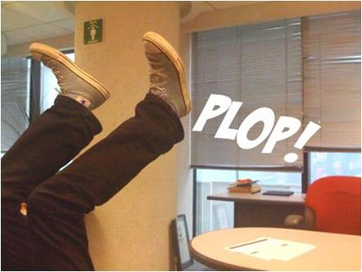
El que sigue!
INSERT INTO ordenat (
num_secordatenc, cod_sectorista,
num_ordenat,
tip_proced, fec_atencion, ... )
TRIGGER: bi_ordatenc
SELECT MAX(TO_NUMBER(num_ordenat))
INTO :NEW.num_ordenat
FROM tabla_det
WHERE tip_modulo = :NEW.tip_modulo;

Slide 43
El que sigue!
Alternativas
INSERT INTO ordenat (
num_secordatenc, cod_sectorista,
num_ordenat,
tip_proced, fec_atencion, ... )
VALUES (
v_nsoa, v_cs,
s_ordenat.NEXTVAL,
v_tp, v_fa, ... )
INSERT INTO ordenat (
num_secordatenc, cod_sectorista,
num_ordenat,
tip_proced, fec_atencion, ... )
VALUES (
v_nsoa, v_cs,
get_ordenat( w_tip_modulo ),
v_tp, v_fa, ... )

Slide 44
Hay filas?
SELECT COUNT(*)
INTO v_existe
FROM table_1
WHERE col_1 = :B1
AND col_2 = :B2;
IF v_existe > 0 THEN . . .

Slide 45
Hay filas?
Alternativa
SELECT COUNT(*)
INTO v_existe
FROM table_1
WHERE col_1 = :B1
AND col_2 = :B2
AND rownum < 2;
IF v_existe > 0 THEN . . .
SELECT COUNT(*)
INTO v_existe
FROM dual
WHERE exists ( SELECT *
FROM table_1
WHERE col_1 = :B1
AND col_2 = :B2 );

Slide 46
Información de sesión
SELECT USERENV('TERMINAL'), USER
INTO w_terminal, w_user
FROM DUAL;
SELECT DISTINCT OSUSER
INTO w_osuser
FROM V$SESSION
WHERE terminal = w_terminal
AND username = w_user
AND status <> 'KILLED';
:NEW.ident := w_user;
:NEW.dsc_userwin := w_osuser;
:NEW.dsc_maquinapc := w_terminal;

Slide 47
Información de sesión
Alternativa
:new.ident := sys_context('userenv','session_user');
:new.dsc_userwin := sys_context('userenv','os_user');
:new.dsc_maquinapc := sys_context('userenv','terminal');
select logon_time
from v$session
where audsid =
sys_context('userenv','sessionid');

Slide 48
Te perdí de vista
CREATE VIEW vw_1 ( col_1, col_2, ... ) AS
SELECT t_1.col_1, t_2.col_2, ...
FROM table_1 t_1, table_2 t_2, ...
CREATE VIEW vw_2 (col_2, col_3, ... ) AS
SELECT v_1.col_2, t_3.col_3, ...
FROM view_1 v_1, table_3 t_3, ...
SELECT col_1, col_3
FROM vw_1, vw_2
WHERE ...

Slide 49
Te perdí de vista
Alternativa
SELECT t_1.col_1, t_3.col_3
FROM table_1 t_1, table_3 t_3
WHERE . . .

Slide 50
Excepciones mal manejadas
PROCEDURE raise_sal ( . . . , err_code OUT NUMBER ) IS
BEGIN
. . .
err_code := 1; -- supera tope
. . .
err_code := 0; -- ok
EXCEPTION
WHEN OTHERS THEN NULL;
END;
RAISE_APPLICATION_ERROR(-20001,'Límite de Operaciones');
RAISE_APPLICATION_ERROR(-20001,'No Existe datos seleccionados');
RAISE_APPLICATION_ERROR(-20001,SUBSTR(SQLCODE||'-'|| SQLERRM,1,512));
BEGIN
raise_sal( . . ., v_error );
IF v_error = 1 THEN
. . .
ELSIF v_error = 2 THEN
. . .
END IF;
END;

Slide 51
Excepciones mal manejadas
Alternativas
PACKAGE empleados IS
e_tope_salarial EXCEPTION;
tope_salarial_c CONSTANT NUMBER(5) := -20200;
tope_salarial_m CONSTANT VARCHAR2(100)
:= 'Incremento supera el tope salarial';
PRAGMA EXCEPTION_INIT(e_tope_salarial, -20200);
. . .
PACKAGE BODY empleados IS
PROCEDURE raise_sal( . . . ) IS
. . .
raise_application_error(
tope_salarial_c, tope_salarial_m);

Slide 52
Excepciones mal manejadas
Alternativas
BEGIN
empleados.raise_sal( . . . );
EXCEPTION
WHEN empleados.e_tope_salarial THEN
. . .
WHEN OTHERS THEN RAISE;
END;
BEGIN
*
ERROR at line 1:
ORA-20200: Incremento supera el tope salarial
ORA-06512: at line 22

Slide 53
Instrumentación inexistente
¿Qué aplicación consume más recursos?
¿Qué usuario consume más recursos?
¿Cómo identifico de qué aplicación proviene una sentencia SQL?
¿Cómo puedo dar prioridad a una aplicación o usuario en particular?
¿Cómo hago trace a un usuario o aplicación cuando hay un pool de conexiones?

Slide 54
Instrumentación inexistente
Alternativa
dbms_application_info.set_module (
module_name => 'Almacenes',
action_name => 'Consulta.Inventario );
dbms_application_info.set_action (
action_name => 'Actualiza.Stock' );
dbms_session.set_identifier(
client_id => 'Juan.Perez' );

Slide 55
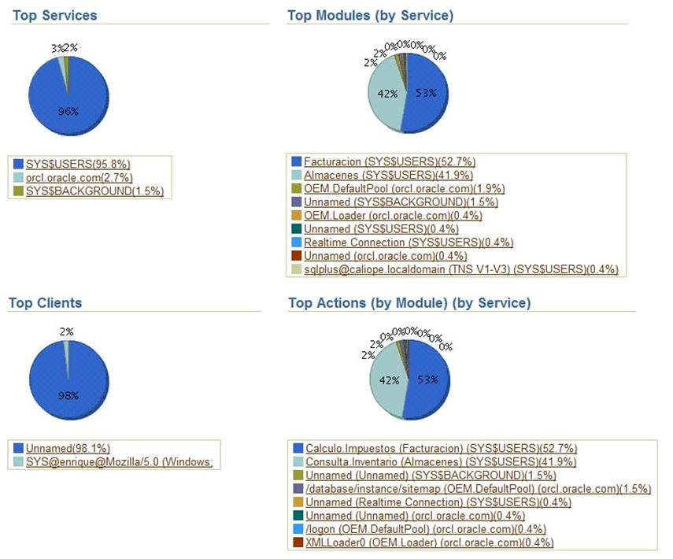
Instrumentación inexistente
Alternativa

Slide 56
Instrumentación inexistente
Alternativa
dbms_monitor.serv_mod_act_trace_enable (
service_name => 'prod.oracle.com',
module_name => 'Almacenes',
action_name => 'Consulta.Inventario );
dbms_monitor.client_id_trace_enable( client_id => 'Juan.Perez' );
$ trcsess output=trace.trc \
clientid= 'Juan.Perez' \
module = 'Almacenes' \
action = 'Consulta.Inventario' *.trc

Slide 57
Conclusiones & recomendaciones
Fijar estándares de programación
Los desarrolladores necesitan capacitación
Limitar el uso de literales en beneficio de variables
Controlar la sobre-indexación
Establecer mecanismo para el control y registro de errores
Debemos instrumentar el código de nuestras aplicaciones
Es necesario evaluar el software que adquirimos

Slide 58
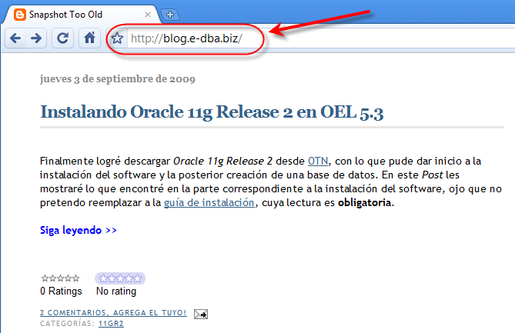
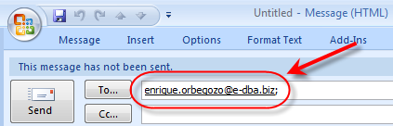
¡Gracias!

